Slide 1
End Term Presentation – Cruise RMS
Krishnaraj Thadesar
Associate Software Developer Intern
14th November 2024

Slide 2
Agenda
Introduction
Project Details
Theoretical Background
Methodology Followed
Data Collection and Analysis
Key Suggestions and Learnings

Slide 3
Theoritical Backgroudn
Me
My Team
Cruise RMS
Part of the Cruise RMS team.
Finished an Angular Training at work.
I intend to also work in making the UI as soon as we finish training.
My team consists of Arun Pratap Singh, Harekishan Shivnani, Sunanda DuttaSen, Rajendra Mulgali and Omkar Chogale
My Mentor and manager is Mr. Harekishan Shivnani.
We are developing a new Product for IDeaS
It involves Forecasting revenue for Cruise Companies.

Slide 4
Cruise RMS
Backend
Database
Frontend
File Processing
Java Spring
Postgres Docker Containers
Relational
Angular
Design process ongoing in Figma

Slide 5



Tasks Completed Till Date – Month 1
Demo Project
Processing Files
Designing Schema
Started with making a demo project to get a hands-on about our tech stack
Process Input files given by client.
Working with my team to design the schema, and learning in depth about it in the process.

Slide 6

Month 2
Process 2 new Files
Analyze Files
Angular Training
Out of Order and Historical Pricing files need to be processed
Perform basic analysis on the file, and try to find any potential errors or edge cases it may have
Attend and learn Angular for building frontend.

Slide 7

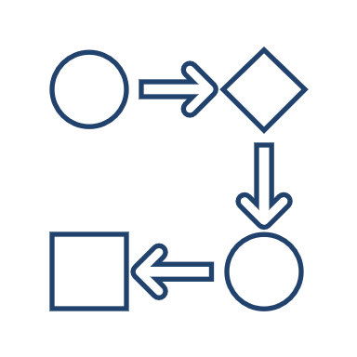

Month 3
Writing API for Forecasting
File Processing workflow
Learning about APIs
Write API calls for Forecasting Page
Try to fix logical inconsistencies in entire file to dB workflow
Learn about best practices with writing APIs and DTOs

Slide 8
Month 4
Writing API for Pricing
And Configuration screen
Working on UI
Learning UI code practices
Write API calls for Pricing screen, along with cabin configuration screen
Writing a new screen – cabin configuration
Angular code practices, CSS, and frontend methodologies

Slide 9






Software and Applications Used

Slide 10

✓
Database Errors and Normalization
✓
Test cases Failing
✓
Non Familiarity with Spring
Challenges Faced

Slide 11
✓
Keeping up with Code Quality
✓
Build failures in github pipeline
Challenges Faced

Slide 12
✓
Getting stuck on slightly challenging tasks
✓
Procrastinating difficult stories in favor of simpler ones
Challenges Faced
✓
Testing work on higher environments

Slide 13
✓
Finding simpler solutions to problems
✓
Build failures in github pipeline
Challenges Faced

Slide 14
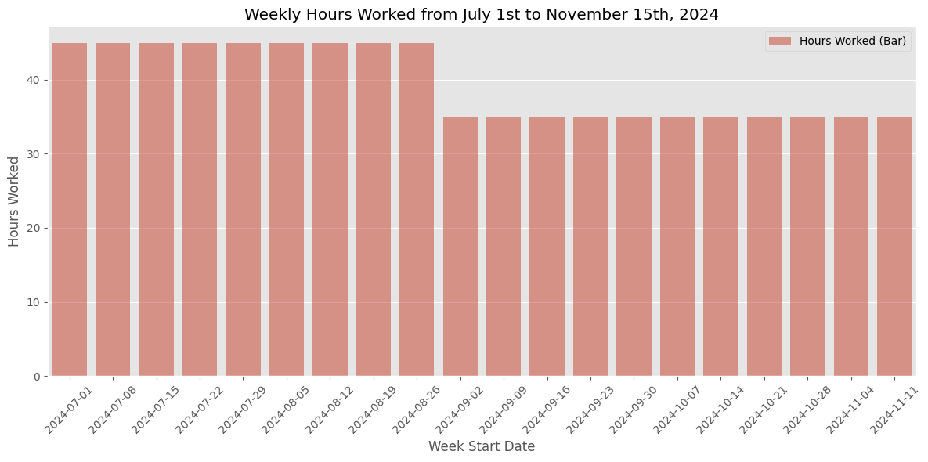
Data Collection and Analysis

Slide 15
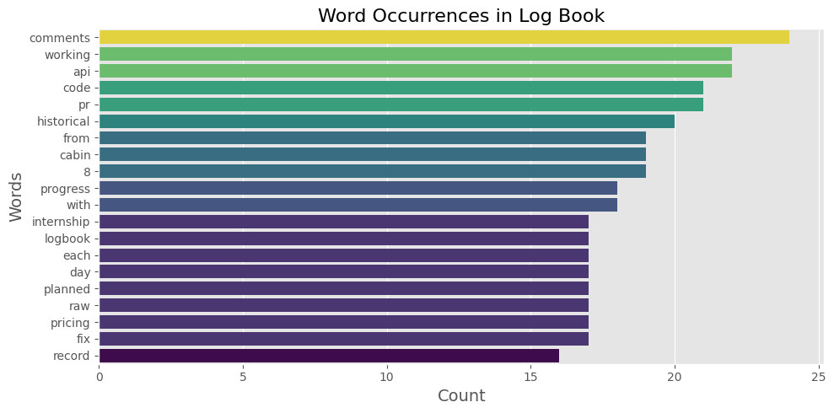

Slide 16
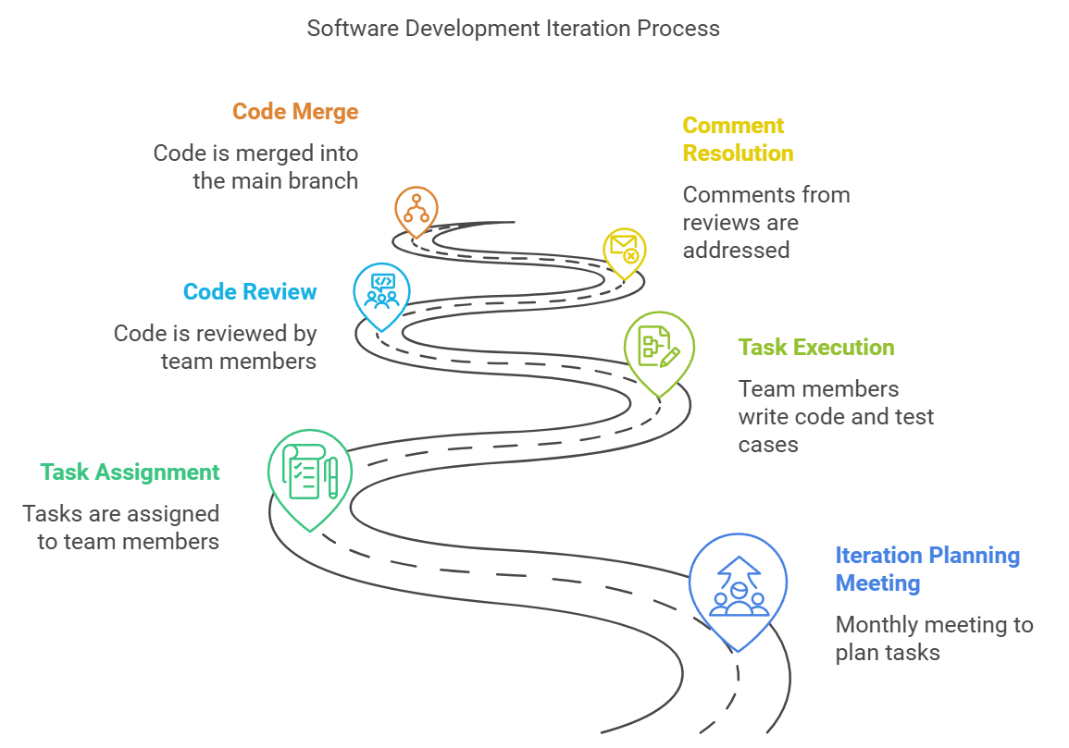
Working Methodology
A task is planned in a meeting held every month – Iteration planning.
Several tasks or stories are assigned to you in this meeting of your choice.
You then pick them up on a daily basis, write code for it, and then write test cases.
Upon finishing the “story” or task, this goes into code review and is reviewed by team members.
Their comments on such reviews are resolved.
Work of that story is considered done, when your work is merged.

Slide 17
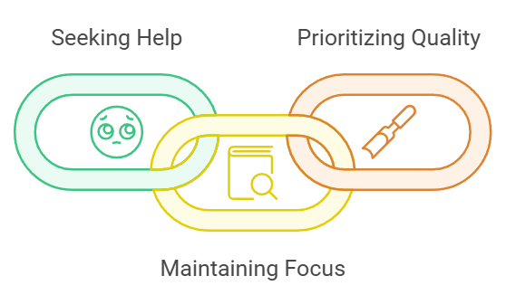
Key Suggestions
Do not get stuck on complicated tasks, take help and move on.
Do not get distracted from one task to another.
Try to focus on assuring better quality of code rather than rushing to completion.

Slide 18
Technical Learnings
While seemingly obvious, simpler solutions to problems are better than more complex ones.
Its important to know what each line and function of your code does. You can work without this too, just not as efficiently.
Indexes are more important in sql than we give them credit for. They are a topic worth learning deeply about.
Best Practices:
Use constants on left side of your “=” in if statements.
Use .equals or such function wherever you can as opposed to symbols.
Use objects instead of primitive values. They are null safe.
Try to use immutable types wherever you can.

Slide 19
Technical Learnings
When a lot of files are conflicting, instead of getting frustrated, its best to resolve it with patience, than losing it. A few patient minutes can avoid hours of work later.
Test your work on dev and higher environments before marking it as done.
Use sonar cloud, and other warnings and code checks intellij offers.
When writing questionable code, try to write it as close to origin of data as possible. That makes it easier to debug.
In using a relational database, normalization is preferred over slight complexity. Simple queries are better than joins, even if you have to make a few tables for it.

Slide 20
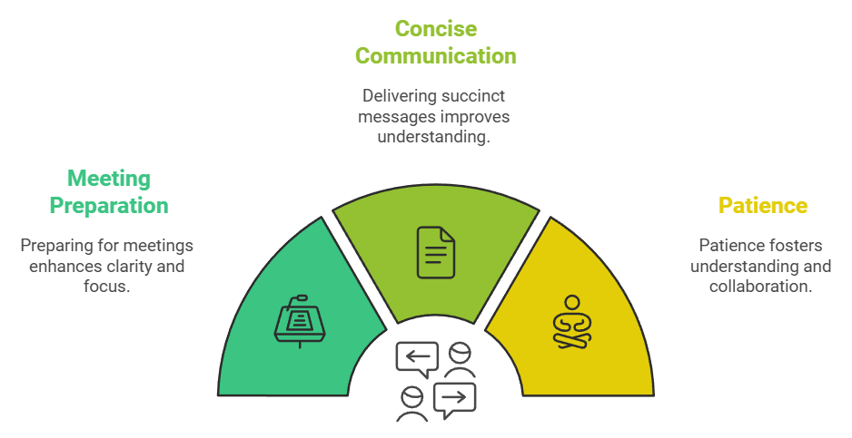
Personal Learnings

